Slide 1

Predicting Academic Outcomes with ML
Using OULAD to forecast student success and enable early intervention.

Slide 2



Authors & Affiliations
Umar Abbasi
Saba Mahmood
Co‑authors
Department of Computer Sciences, Bahria University — Corresponding author
Rabdan Academy — Contributing author
Ali Daud, Saad Shakeel, Abdul Qadeer — Contributed equally

Slide 3

Why this study
Context
Gap
Goal
VLEs produce rich behavior data; need predictive tools.
Combine demographics + granular engagement for actionable models.
Early identification of at‑risk students for intervention.

Slide 4

Dataset & Preprocessing
OULAD — 32,593 student records
Missing records omitted (no imputation)
One‑hot encoding; Min‑Max scaling
Outcomes: distinction, pass, withdrawal, fail

Slide 5

Feature Engineering & Selection
Behavioral features
Login frequency, resource access, assessment consistency
Selection
Recursive Feature Elimination (RFE) to prioritize predictors
Top predictors
Prior education, IMD band, age band, engagement metrics

Slide 6


Models Compared
Decision Tree
Gradient Boosting
Random Forest
Interpretable baseline
Iterative error reduction
Ensemble — best accuracy & robustness

Slide 7
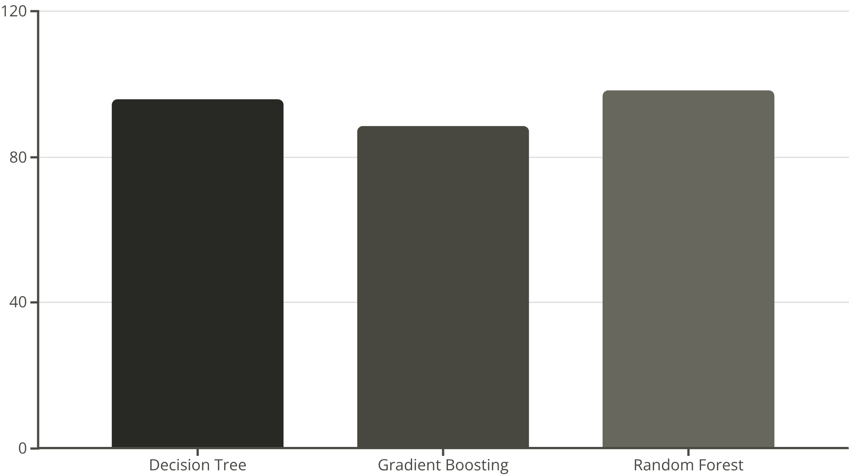
Performance & Key Result
Random Forest achieved peak accuracy: 98.3%.
Decision Tree: 95.7%
Gradient Boosting: 88.5%
Random Forest: 98.3% (best)

Slide 8
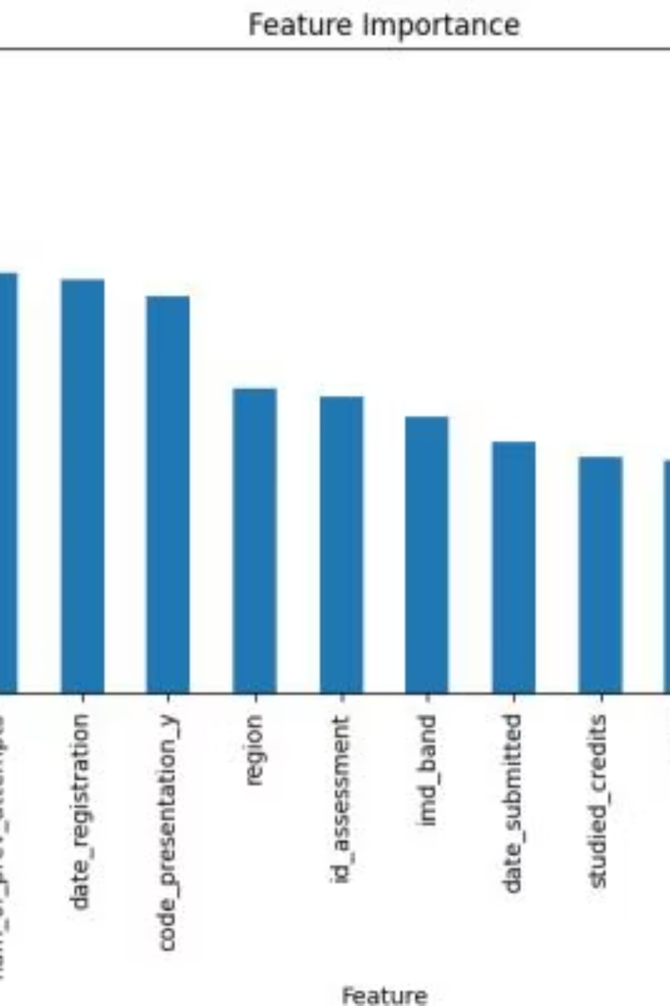
Feature Importance
Top influences: prior education, IMD band, engagement metrics, age band.

Slide 9

Interventions & Implications
Identify
Detect at‑risk students early using model outputs
Personalize
Tailor learning plans and mentoring
Support
Targeted resources, financial/academic aid

Slide 10

Conclusions & Next Steps
Future Work
Deep learning exploration
Explainable AI (SHAP, LIME)
Broader dataset integration
Real‑time intervention systems
Conclusion
Random Forest best: 98.3% — demographics + engagement predict success.

